Slide 1
Data Science
Session – 14
Date – 15th June, 2022

Slide 2
What Is Kurtosis?
Kurtosis is used to find the presence of outliers in our data. It gives us the total degree of outliers present.
The data can be heavy-tailed, and the peak can be flatter, almost like punching the distribution or squishing it. This is called Negative Kurtosis (Platykurtic). If the distribution is light-tailed and the top curve steeper, like pulling up the distribution, it is called Positive Kurtosis (Leptokurtic).
The expected value of kurtosis is 3. This is observed in a symmetric distribution. A kurtosis greater than three will indicate Positive Kurtosis. In this case, the value of kurtosis will range from 1 to infinity. Further, a kurtosis less than three will mean a negative kurtosis. The range of values for a negative kurtosis is from -2 to infinity. The greater the value of kurtosis, the higher the peak.
Hence, you can say that Skewness and Kurtosis are used to describe the spread and height of your normal distribution. Skewness is used to denote the horizontal pull on the data. It tells you how spread out the data is, and Kurtosis is used to find the vertical pull or the peak's height.

Slide 3
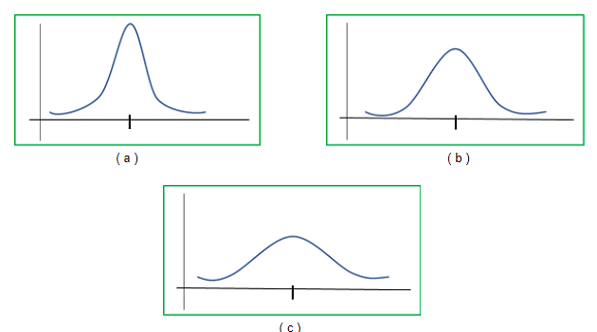
What Is Kurtosis?
(a) Leptokurtic, (b) Normal Distribution, (c) Platykurtic

Slide 4
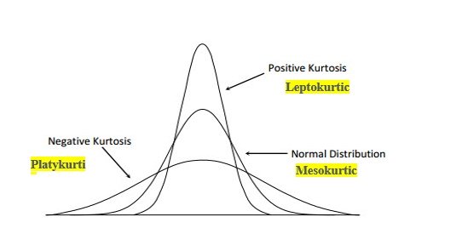
What Is Kurtosis?
Kurtosis is a statistical measure, whether the data is heavy-tailed or light-tailed in a normal distribution.
In finance, kurtosis is used as a measure of financial risk. A large kurtosis is associated with a high level of risk for an investment because it indicates that there are high probabilities of extremely large and extremely small returns. On the other hand, a small kurtosis signals a moderate level of risk because the probabilities of extreme returns are relatively low.

Slide 5
Excess Kurtosis
The excess kurtosis is used in statistics and probability theory to compare the kurtosis coefficient with that normal distribution. Excess kurtosis can be positive (Leptokurtic distribution), negative (Platykurtic distribution), or near to zero (Mesokurtic distribution). Since normal distributions have a kurtosis of 3, excess kurtosis is calculating by subtracting kurtosis by 3.
Excess kurtosis = Kurt – 3
Types of excess kurtosis
Leptokurtic or heavy-tailed distribution (kurtosis more than normal distribution).
Mesokurtic (kurtosis same as the normal distribution).
Platykurtic or short-tailed distribution (kurtosis less than normal distribution).

Slide 6
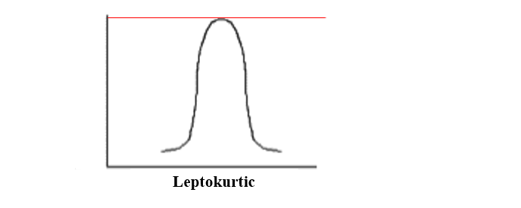
Leptokurtic (kurtosis > 3)
Leptokurtic is having very long and skinny tails, which means there are more chances of outliers. Positive values of kurtosis indicate that distribution is peaked and possesses thick tails. An extreme positive kurtosis indicates a distribution where more of the numbers are located in the tails of the distribution instead of around the mean.

Slide 7
Platykurtic (kurtosis < 3)
Platykurtic having a lower tail and stretched around center tails means most of the data points are present in high proximity with mean. A platykurtic distribution is flatter (less peaked) when compared with the normal distribution.

Slide 8
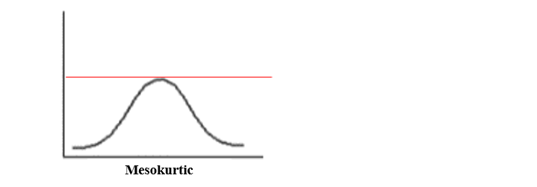
Mesokurtic (kurtosis = 3)
Mesokurtic is the same as the normal distribution, which means kurtosis is near to 0. In Mesokurtic, distributions are moderate in breadth, and curves are a medium peaked height.

Slide 9
CONCLUSION
The skewness is a measure of symmetry or asymmetry of data distribution, and kurtosis measures whether data is heavy-tailed or light-tailed in a normal distribution. Data can be positive-skewed (data-pushed towards the right side) or negative-skewed (data-pushed towards the left side).
When data skewed, the tail region may behave as an outlier for the statistical model, and outliers unsympathetically affect the model’s performance especially regression-based models. Some statistical models are hardy to outliers like Tree-based models, but it will limit the possibility to try other models. So there is a necessity to transform the skewed data to close enough to a Normal distribution.

Slide 10
scipy stats.kurtosis() function
scipy.stats.kurtosis(array, axis=0, fisher=True, bias=True) function calculates the kurtosis (Fisher or Pearson) of a data set. It is the the fourth central moment divided by the square of the variance. It is a measure of the “tailedness” i.e. descriptor of shape of probability distribution of a real-valued random variable. In simple terms, one can say it is a measure of how heavy tail is compared to a normal distribution.
Parameters :
array : Input array or object having the elements.
axis : Axis along which the kurtosis value is to be measured. By default axis = 0.
fisher : Bool; Fisher’s definition is used (normal 0.0) if True; else Pearson’s definition is used (normal 3.0) if set to False.
bias : Bool; calculations are corrected for statistical bias, if set to False.
Returns : Kurtosis value of the normal distribution for the data set.

Slide 11
Code #1:
# Graph using numpy.linspace() finding kurtosis
from scipy.stats import kurtosis
import numpy as np
import pylab as p
x1 = np.linspace( -5, 5, 1000 )
y1 = 1./(np.sqrt(2.*np.pi)) * np.exp( -.5*(x1)**2 )
p.plot(x1, y1, '*')
print( '\nKurtosis for normal distribution :', kurtosis(y1))
print( '\nKurtosis for normal distribution :',
kurtosis(y1, fisher = False))
print( '\nKurtosis for normal distribution :',
kurtosis(y1, fisher = True))

Slide 12
Inferential Statistics
Inferential statistics is a branch of statistics that makes the use of various analytical tools to draw inferences about the population data from sample data. Apart from inferential statistics, descriptive statistics forms another branch of statistics. Inferential statistics help to draw conclusions about the population while descriptive statistics summarizes the features of the data set.
There are two main types of inferential statistics - hypothesis testing and regression analysis. The samples chosen in inferential statistics need to be representative of the entire population. In this article, we will learn more about inferential statistics, its types, examples, and see the important formulas.

Slide 13
What is Inferential Statistics?
Inferential statistics helps to develop a good understanding of the population data by analyzing the samples obtained from it. It helps in making generalizations about the population by using various analytical tests and tools. In order to pick out random samples that will represent the population accurately many sampling techniques are used. Some of the important methods are simple random sampling, stratified sampling, cluster sampling, and systematic sampling techniques.
Inferential statistics can be defined as a field of statistics that uses analytical tools for drawing conclusions about a population by examining random samples. The goal of inferential statistics is to make generalizations about a population. In inferential statistics, a statistic is taken from the sample data (e.g., the sample mean) that used to make inferences about the population parameter (e.g., the population mean).

Slide 14
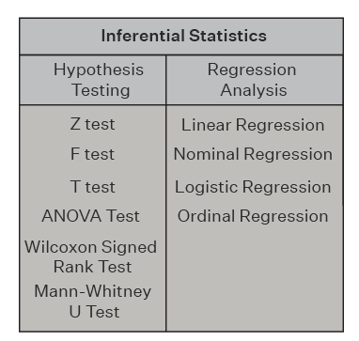
Types of Inferential Statistics
Inferential statistics can be classified into hypothesis testing and regression analysis. Hypothesis testing also includes the use of confidence intervals to test the parameters of a population. Given below are the different types of inferential statistics.

Slide 15
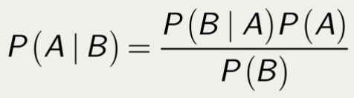
Conditional Probability
Conditional probability is the probability of a particular event A, given a certain condition which has already occurred, i.e., B. Then conditional probability, P(A|B) is defined as,

Slide 16
Probability Distribution and Distribution function
The mathematical function describing the randomness of a random variable is called a probability distribution. It is a depiction of all possible outcomes of a random variable and its associated probabilities.

Slide 17
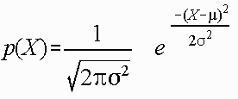
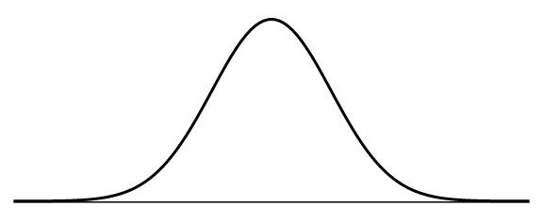
Normal distribution
The normal distribution is a continuous probability distribution that is described by Normal Equation,
A Normal distribution curve is symmetrical on both sides of the mean, so the right side of the center is a mirror image of the left side.
The area under the normal distribution curve represents probability, and the total area under the curve sums to one.

Slide 18
Normal distribution
A Normal distribution curve has the following properties:
mean, median, and mode are equal.
The curve is symmetric, with half of the values on the left and half of the values on the right.
The area under the curve is 1.
A Normal distribution follows the Empirical rule, which states that:
68%of the data falls within 1 standard deviation of the mean
95%of the data falls within 2 standard deviations of the mean
7%of the data falls within 3 standard deviations of the mean.
The normal distribution is the most significant probability distribution in statistics because many continuous data in nature and psychology displays this bell-shaped curve when compiled and graphed.
For example, if we randomly sampled 50 people, we would expect to see a normal distribution frequency curve for many continuous variables, such as IQ, height, weight, and blood pressure.

